Slide 1

18ECC301T – Wireless Communications
Unit IV –Improvement on Link Performance
Week 1 : Introduction to diversity, equalization and capacity, Space diversity, Scanning diversity, Maximal ratio combiner, Equal gain diversity,
Week 2: Rake Receiver, Capacity in AWGN, Capacity of flat fading channels, Equalizer and its mode, Adaptive equalizer block diagram
Week 3: Types of Equalizers - elementary level only, Introduction to MIMO antennas, Case study: Recent trends in Diversity and MIMO antenna
References :
Rappaport T.S, “Wireless Communications: Principles and Practice”, Pearson education, 2nd edition, 2009.
Andrea Goldsmith, “Wireless Communications”, Cambridge University Press, Aug 2005

Slide 2
WEEK-1
Introduction to diversity, equalization and capacity, Space diversity, Scanning diversity, Maximal ratio combiner, Equal gain diversity
Courtesy:
Rappaport T.S, “Wireless Communications: Principles and Practice”, Pearson education.

Slide 3
Diversity - Introduction
Diversity – a powerful communication receiver technique that provides wireless link improvement at a relatively low cost.
Diversity techniques are used in wireless communications systems to primarily to improve performance over a fading radio channel
The receiver is provided with multiple copies of the same information signal which are transmitted over two or more communication channels.
Basic idea of diversity is repetition or redundancy of information.

Slide 4
Diversity - Introduction
Different techniques that improves mobile radio-link performance without
altering air interface
increasing transmit power
increasing bandwidth
1. Diversity - used to reduce depth and duration of fades due to motion
2. Equalization - used to counter Inter-Symbol Interference (ISI) - time dispersion
3. Channel Coding - coded bits to improve small-scale link performance
These techniques are used to improve Rx signal quality and lower BER, which can be used independently or together

Slide 5
Diversity - Introduction
These techniques improve mobile radio link performance
Effectiveness of each varies widely in practical wireless systems
Cost and complexity are also important issues

Slide 6
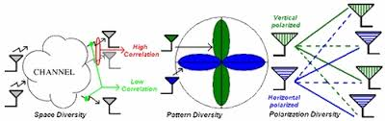
Diversity Concept
If one radio path undergoes a deep fade, another independent path may have a strong signal
By having more than one path to select from, both the instantaneous and average SNRs at the receiver may be improved

Slide 7
Diversity Types
Diversity
Macroscopic Diversity
Microscopic Diversity
Prevents Large Scale fading.
This fading is prevented by selecting an antenna which is not shadowed, this allows increase in the signal-to-noise ratio
Macroscopic Diversity
Prevents Small Scale fading
This fading is prevented by selecting an antenna which gives a strong signal that mitigates this small signal fading effect.
Microscopic Diversity

Slide 8
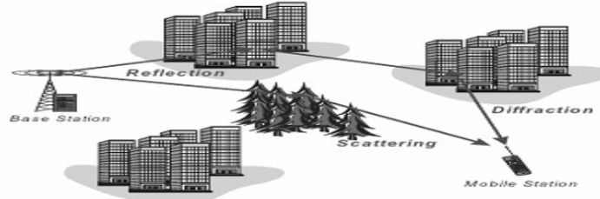
Diversity Types
Diversity to mitigate the effects of shadowing from buildings and objects is called macrodiversity.
Diversity techniques that mitigate the effect of multipath fading are called microdiversity.
Mobile
Antennas
BS Receiver

Slide 9
Diversity Techniques
Diversity – a powerful communication receiver technique that provides wireless link improvement at a relatively low cost.
compensates impairments of fading channel.
Primary goal is to reduce depth and duration of small-scale fades
Diversity techniques are used in wireless communications systems to primarily to improve performance over a fading radio channel
Requires no training overhead
Can provides significant link improvement with little added cost
Diversity decisions are made by the Rx, and are unknown to the Tx
Transmit Diversity
Spatial Diversity
Polarization Diversity
Frequency Diversity
Time Diversity

Slide 10
Key Takeaways
Diversity requires a training sequence.
a) True b) False
Diversity decisions are made by ____________
a) Receiver b) Transmitter
c) Channel d) Adaptive algorithms
Small scale fades are characterized by ____________ amplitude fluctuations.
a) Large b) Small
c) Rapid d) Slow
____________ is used to prevent deep fade for rapidly varying channel.
a) Modulation b) Demodulation
c) Macroscopic diversity technique d) Microscopic diversity technique
Large scale fading can be mitigated with the help of _________
a) Modulation b) Demodulation
c) Macroscopic diversity technique d) Microscopic diversity technique

Slide 11
Diversity Techniques
Techniques that help to reduce depth and duration of small-scale fades

Slide 12
Diversity Techniques
Transmit Diversity: (used in 3G) - BST transmits replica signals separated by frequency and spatially separated antennas
Spatial Diversity (most common) - multiple receive antennas spaced to achieve uncorrelated fading. :Using antennas spaced enough (at Tx or Rx).
one antennas see peak & while other see nulls
receiver selects strongest signal
Polarization Diversity - Using antennas with different polarizations
Frequency Diversity - Using frequency channels separated in frequency more than the channel coherence bandwidth
Time Diversity - Using time slots separated in time more than the channel coherence time.

Slide 13
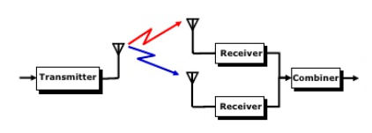
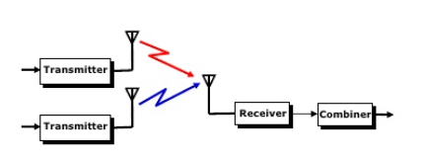
Space Diversity
Method of transmission or reception, or both, in which the effects of fading are minimized by the simultaneous use of two or more physically separated antennas, ideally separated by one half or more wavelengths.
Types
Space Diversity
.
Spatial separation between antennas, so that the diversity branches experience uncorrelated fading •More hardware/ antennas Receiver • (•r The total transmitted power is Receiver Transmitter Combiner split among the antennas Open loop/ close loop (for 3G)
Receiver Diversity (SIMO)
Transmit Diversity (MISO)
Antenna separation λ/2 Receiver
Antenna separation 10λ Transmitter

Slide 14
Space Diversity Techniques
Space Diversity is also known as Antenna Diversity or Spatial diversity.
It is one of the diversity schemes that uses two or more antennas to improve the quality and reliability of a wireless link
Space Diversity
Selection Diversity
Scanning Diversity
Maximum Ratio Combining
Equal Gain Combining

Slide 15
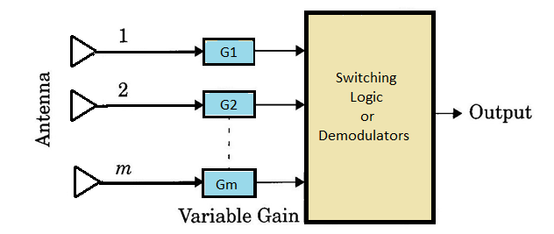
Space Diversity
Generalized block diagram of Space Diversity
Space diversity methods:
1) Selection Diversity
2) Feedback Diversity
3) Maximal Radio Combining
4) Equal Gain Diversity

Slide 16
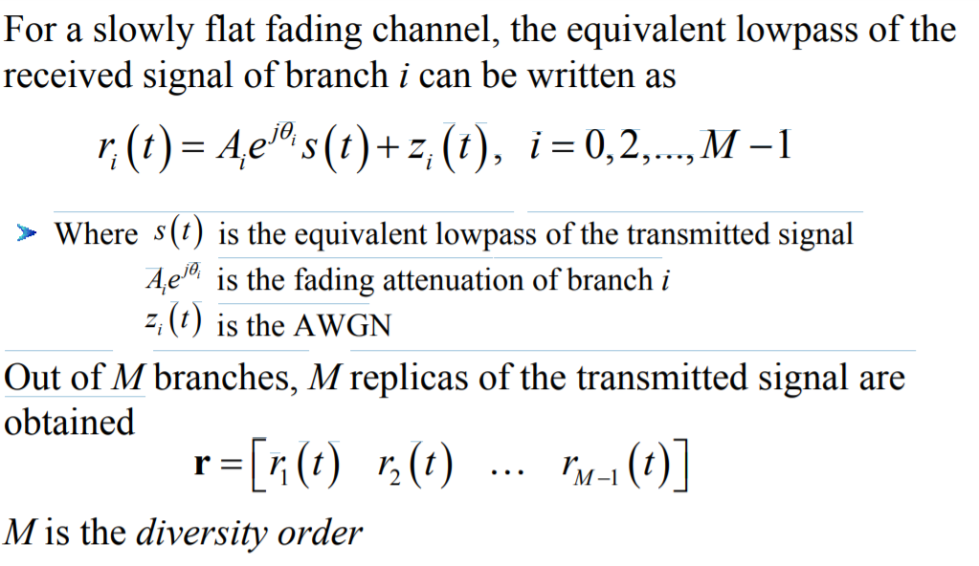
Selection Diversity

Slide 17
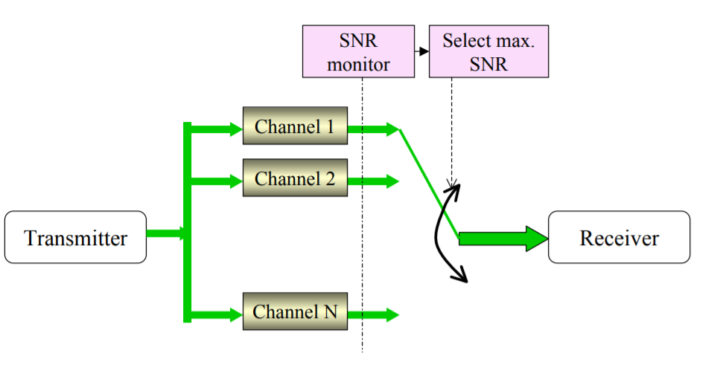
Selection Combining
Select the Strongest Signal
The receiver branch having the highest instantaneous SNR is connected to the demodulator.

Slide 18
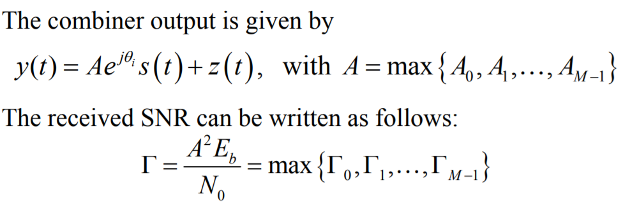
Selection Combining

Slide 19

Selection Combining
In selection combining (SC), the combiner outputs the signal on the branch with the highest SNR
Since only one branch is used at a time, SC often requires just one receiver that is switched into the active antenna branch.
However, a dedicated receiver on each antenna branch may be needed for systems that transmit continuously in order to simultaneously and continuously monitor SNR on each branch.

Slide 20
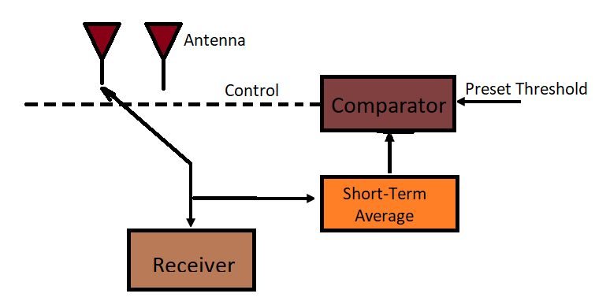
Feedback or Scanning Combining
Scan each antenna until a signal is found that is above predetermined threshold
If signal drops below threshold → rescan
Only one Rx is required (since only receiving one signal at a time), so less costly → still need multiple antennas

Slide 21
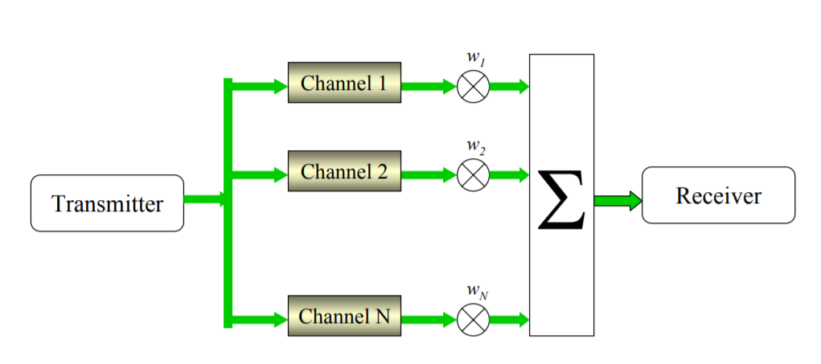
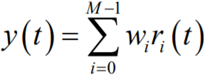
Maximum Ratio Combining (MRC)
Weight branches for maximum SNR
MRC produces an output SNR equal to sum of the individual SNR.
It produces an output with an acceptable SNR even when none of the individual signals are themselves acceptable.
Select path with best SNR or combine multiple paths to improve overall SNR performance

Slide 22
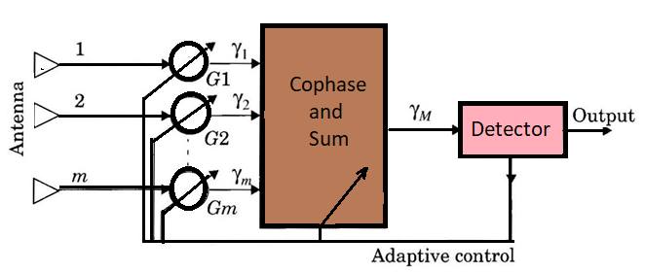
Maximal Ratio Combining (MRC)
MRC Impairments:
1) ACI/CCI → system generated interference
2) Shadowing → large-scale path loss from LOS obstructions
3) Multipath Fading → rapid small-scale signal variations
4) Doppler Spread → due to motion of mobile unit
These can lead to significant distortion or attenuation of Rx signal : Degrade Bit Error Rate (BER) of digitally modulated signal
Maximal Ratio Combiner
‹#›

Slide 23



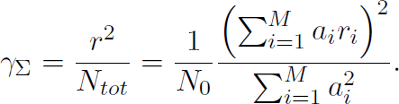



Maximal Ratio Combining (MRC)
In maximal ratio combining (MRC) the output is a weighted sum of all branches, so the in are all nonzero.
The envelope of the combiner output will be .
Assuming the same noise PSD at the combiner output of
Thus, the output SNR of the combiner is
in each branch yields a total noise PSD
.
The goal is to chose the to maximize
. Intuitively, branches with a
high SNR should be weighted more than branches with a low SNR, so the
weights should be proportional to the branch SNRs
.
Solving for the optimal weights yields combiner SNR becomes
, and the resulting
.
Thus, the SNR of the combiner output is the sum of SNRs on each branch.

Slide 24

Equal Gain Combining (EGC)
Simplified Method of Maximal Ratio Combining
Combine multiple signals into one
The phase is adjusted for each receive signal so that
The signal from each branch are co-phased
Vectors add in-phase
Coherent combining of all branches with equal gain
Basic concept
Each branch signal is rotated by
All branch signals are then added

Slide 25
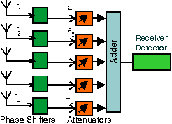
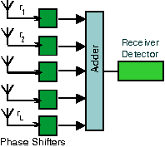
Equal Gain Combining (EGC)
In EGC, each signal branch weighted with the same factor, irrespective of the signal amplitude.
However, co-phasing of all signal is needed to avoid signal cancellation.
EGC is simpler to implement than MRC.
The adaptively controller amplifiers / attenuators are not needed.
No channel amplitude estimation is needed.

Slide 26
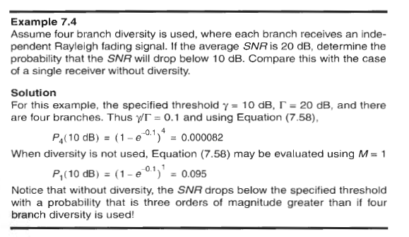
Problem

Slide 27
Frequency Diversity
The same information signal is transmitted and received simultaneously on two or more independent fading carrier frequency.
Basic Idea : If the frequencies are separated by more than the coherence bandwidth of the channel, then the same fading is not experienced.
This techniques requires spare BW, as many as receiver as their channel used for frequency diversity, each one is tuned to different frequencies.
Expensive with respect to bandwidth.

Slide 28
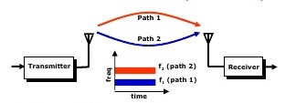
Frequency Diversity
Allows the transmission of the same message signal at different carrier frequencies.
In order for the received signals to be statistically independent or at least uncorrelated, the carrier frequencies must have a separation that is greater than the coherence bandwidth of the radio channel.
The coherence bandwidth depends on the multipath delay spread of the channel.
One limitation of this technique is the ability of the receiver to pick up all these signals

Slide 29
Frequency Diversity
It is not common to actually repeat the same message signal at two different frequencies, as this would greatly decrease spectral efficiency.
Instead, the signal is spread over a large bandwidth, so parts of the signal are conveyed by different frequency components.

Slide 30
Time Diversity
Repeatedly transmits information at the time spacing that exceeds the coherence time of the channel.
The time interval depends on the fading rate, and increases with the decrease in the rate of fading.
Multiple repetitions of the signals will be received with independent fading conditions, thereby providing diversity.
Our modern implementation of time diversity involves the use of RAKE receiver for spread spectrum CDMA.
Note : Coherence Time is the time over which a fading signal can be considered to have similar characteristics)

Slide 31
Self Test
Space diversity s also known as ________ diversity.
a) Antenna b) Time
c) Frequency d) Polarization
Which of the following is not a category of space diversity technique?
a) Selection diversity b) Time diversity
c) Feedback diversity d) Equal gain diversity
In selection diversity, the gain of each diversity branch provides different SNR.
a) True b) False
In maximal ratio combining, the output SNR is equal to ______
a) Mean of all individual SNRs b) Maximum of all SNRs
c) Sum of individual SNR d) Minimum of all SNRs

